Slide 1
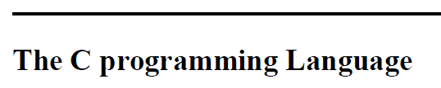
Engineering Computing I
Chapter 1 – Part B
A Tutorial Introduction ^{continued}

Slide 2
Character Input and Output
c = getchar();
reads the next input character from a text stream
Variable ‘c’

Slide 3

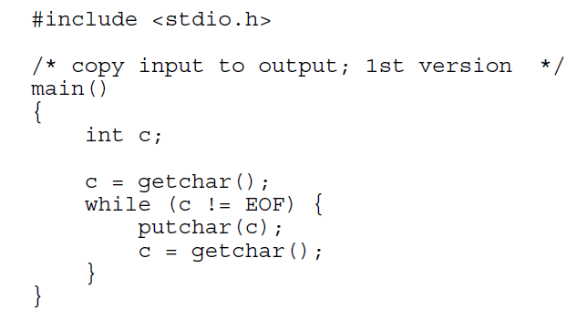
File Copying

Slide 4
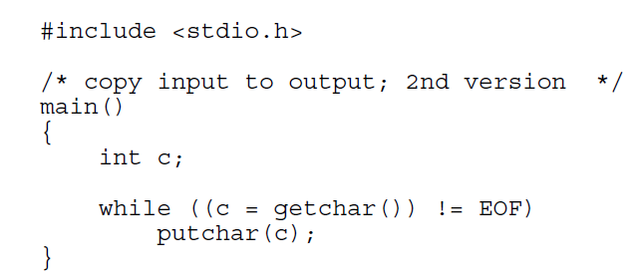
File Copying
Compact Form
The parentheses around the assignment, within the condition are necessary!
c = getchar() != EOF
➔
c = (getchar() != EOF)

Slide 5
Exercises
Exercise 1-6. Verify that the expression getchar() != EOF is 0 or 1
Exercise 1-7. Write a program to print the value of EOF

Slide 6
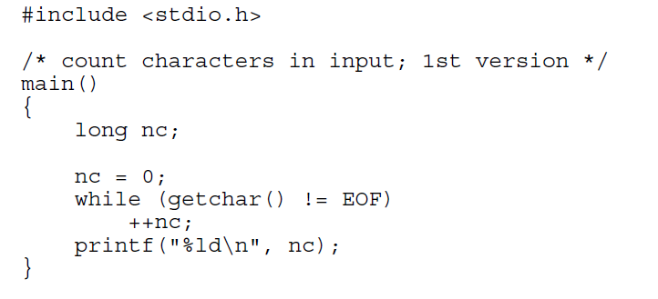
Character Counting
Auto-increment
Equivalent to:
nc = nc +1;

Slide 7
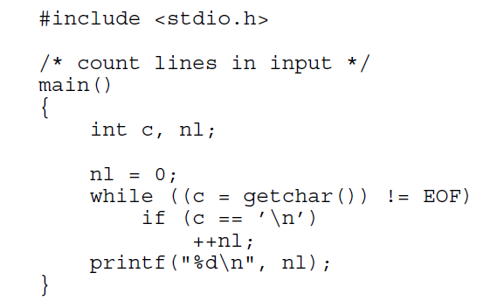
Line Counting

Slide 8
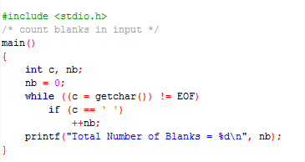
Exercise
Write a program named BlankCounting.c to count blanks.

Slide 9
Word Counting
Pseudo Code
Initialize
  State = OUT /* start assuming not within a word */
  nc = nl = nw = 0 /* all counters are cleared*/
while (c= character) != EOF
{
  ++nc
  if c== \nl
    ++nl
  if c is a white character – i.e. ‘ ‘, ‘\n’ or ‘\t’
    State = OUT /* start of the none white character will create a word */
  else if State == OUT
    State = IN
    ++nw
}
This*is**a*test!
c
State
nc
nl
nw

Slide 10
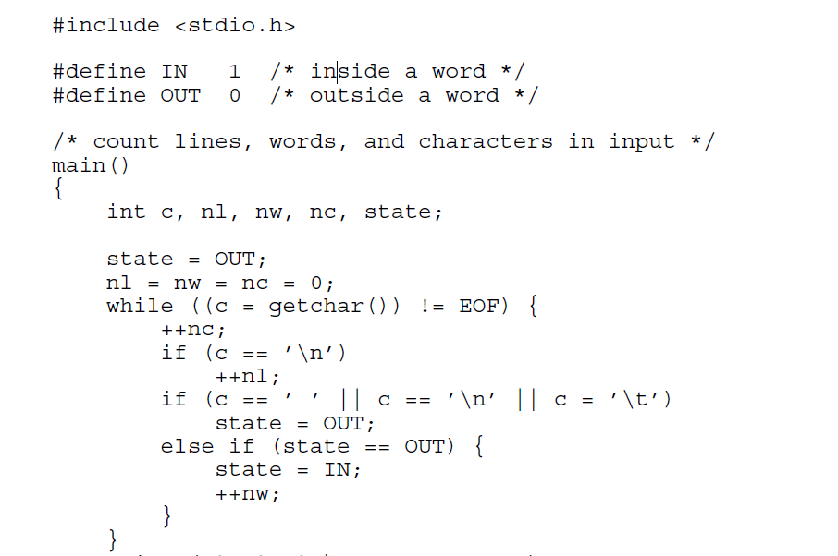
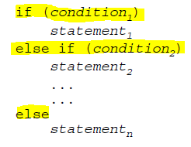
Word Counting

Slide 11
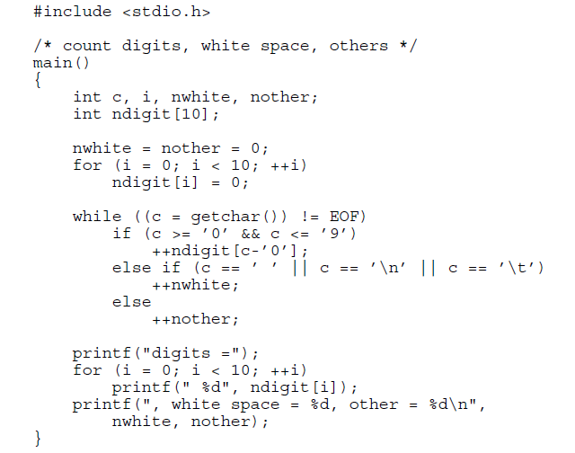
1.6 Arrays
write a program to count the number of occurrences of each digit, of white space characters (blank, tab, newline), and of all other characters

Slide 12
Exercise
Write a program to count the number of occurrences of all “vowels”, i.e. ‘a’, ‘e’, ‘i’ , ‘o’ and ‘u’. Use an array of counters.

Slide 13

A function provides a convenient way to encapsulate some computation, which can then be used without worrying about its implementation.
With properly designed functions, it is possible to ignore how a job is done; knowing what is done is sufficient.
functions like printf, getchar and putchar have been supplied by C Library
Write the function power(m,n) to raise an integer m to a positive integer power n. That is, the value of power(2,5) is 32

Slide 14
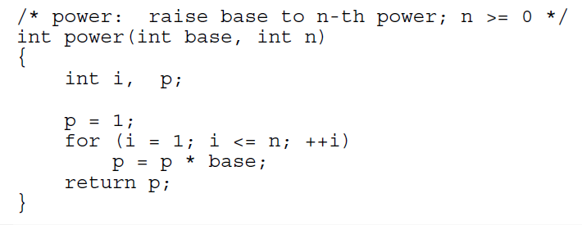
function power(m,n)
A function definition has this form:
return-type function-name(parameter declarations, if any)
{
declarations
Statements
return expression;
}

Slide 15
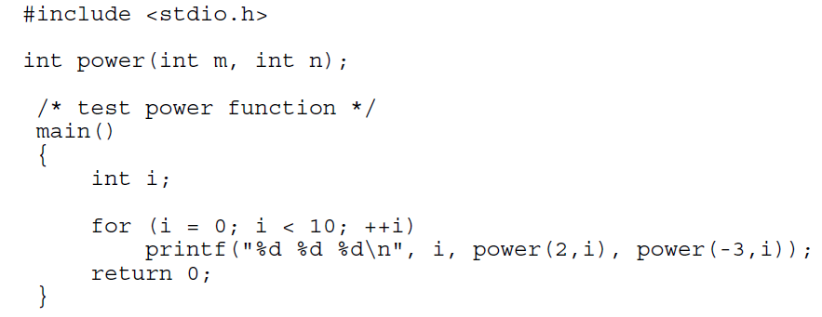
How to Call a Function

Slide 16
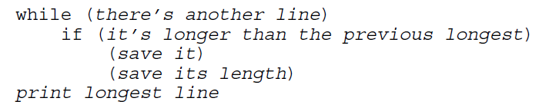
1.9 Character Arrays
The most common type of array in C is the array of characters
write a program that reads a set of text lines and prints the longest

Slide 17
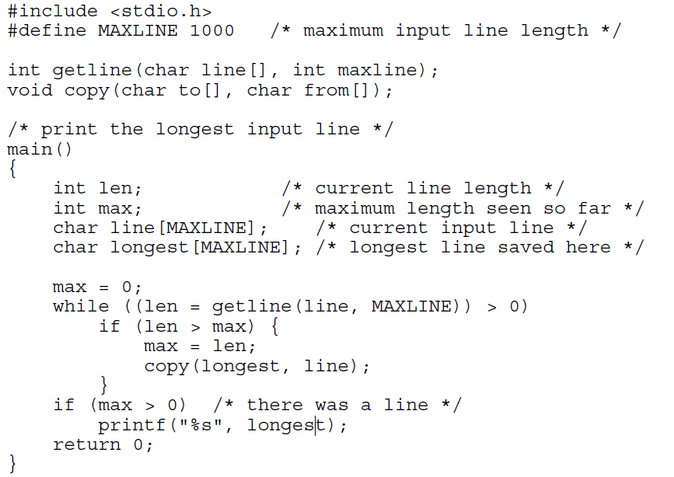

Slide 18
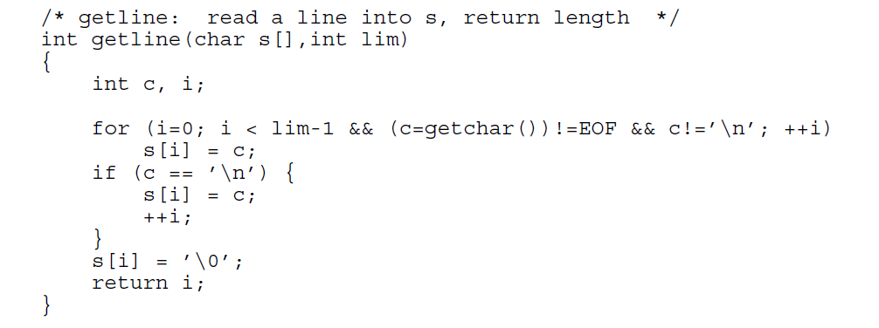
getline: read a line into s, return length

Slide 19
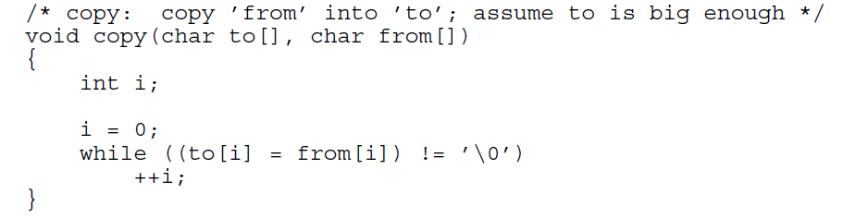
Copy : copy ’from’ into ’to’; assume ‘to’ is big enough

Slide 20
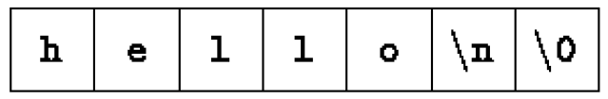
How Strings Are Stored!
"hello\n"

